Slide 1
Regression
Chapter 13
Chap 13-<number>

Slide 2
Learning Objectives
In this chapter, you learn:
How to use regression analysis to predict the value of a dependent variable based on an independent variable
The meaning of the regression coefficients b₀ and b₁
How to evaluate the assumptions of regression analysis and know what to do if the assumptions are violated
To make inferences about the slope and correlation coefficient
To estimate mean values and predict individual values
Chap 13-<number>

Slide 3
Introduction to
Regression Analysis
Regression analysis is used to:
  Predict the value of a dependent variable based on the value of at least one independent variable
  Explain the impact of changes in an independent variable on the dependent variable
Dependent variable: the variable we wish to
predict or explain
Independent variable: the variable used to predict or explain the dependent variable
Chap 13-<number>

Slide 4
Simple Linear Regression Model
Only one independent variable, X
Relationship between X and Y is described by a linear function
Changes in Y are assumed to be related to changes in X
Chap 13-<number>

Slide 5
Types of Relationships
Linear relationships
Nonlinear relationships
Y
Y
X
X
Y
Y
X
X
Chap 13-<number>

Slide 6
Types of Relationships
(continued)
Strong relationships
Weak relationships
Y
Y
X
X
Y
Y
X
X
Chap 13-<number>

Slide 7
Types of Relationships
(continued)
No relationship
Y
X
Y
X
Chap 13-<number>

Slide 8
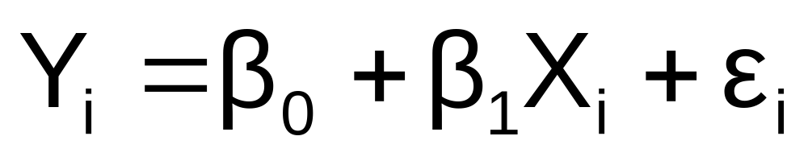
Simple Linear Regression Model
Population Slope
Coefficient
Random Error term
Population
Y intercept
Independent Variable
Dependent Variable
Linear component
Random Error
component
Chap 13-<number>

Slide 9
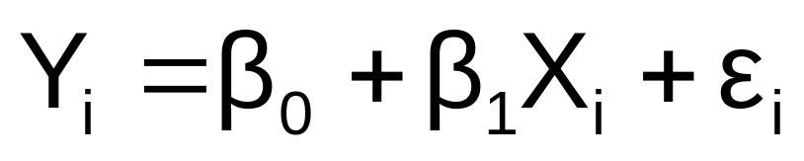
Simple Linear Regression Model
(continued)
Y
Observed Value of Y for X_{i}
ε_{i}
Slope = β₁
Predicted Value of Y for X_{i}
Random Error for this X_{i} value
Intercept = β₀
X_{i}
X
Chap 13-<number>

Slide 10
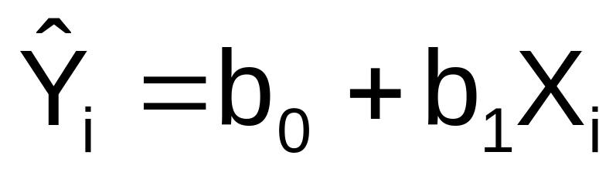
Simple Linear Regression Equation (Prediction Line)
The simple linear regression equation provides an estimate of the population regression line
Estimated (or predicted) Y value for observation i
Estimate of the regression
intercept
Estimate of the regression slope
Value of X for observation i
Chap 13-<number>

Slide 11
Interpretation of the
Slope and the Intercept
b₀ is the estimated average value of Y when the value of X is zero
b₁ is the estimated change in the average value of Y as a result of a one-unit increase in X
Chap 13-<number>

Slide 12

The Least Squares Method
b₀ and b₁ are obtained by finding the values of that minimize the sum of the squared differences between Y and :
Chap 13-<number>

Slide 13
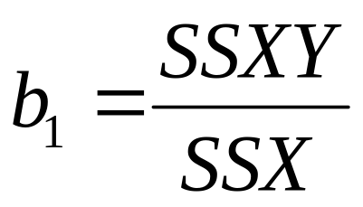
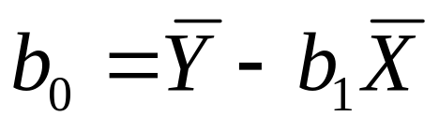
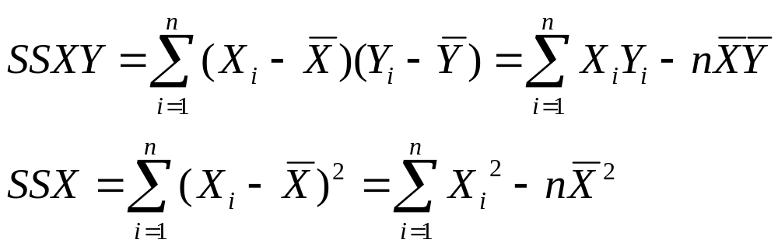
The Least Squares Estimates
Slope
Intercept
where
Chap 13-<number>

Slide 14
Examples
#13.3
#13.4 (take X₁, X₂, X₃, X₄, X₅, X₆)
#13.9, 13.10 (use Excel)
Excel commands:
=slope computes the slope
=intercept computes the intercept
Data Analysis Toolpak computes everything
Chap 13-<number>

Slide 15

Simple Linear Regression Example
A real estate agent wishes to examine the relationship between the selling price of a home and its size (measured in square feet)
A random sample of 10 houses is selected
  Dependent variable (Y) = house price in $1000s
  Independent variable (X) = square feet
Chap 13-<number>

Slide 16
Simple Linear Regression Example: Data
House Price in $1000s (Y) | Square Feet (X)
245 | 1400
312 | 1600
279 | 1700
308 | 1875
199 | 1100
219 | 1550
405 | 2350
324 | 2450
319 | 1425
255 | 1700
Chap 13-<number>

Slide 17
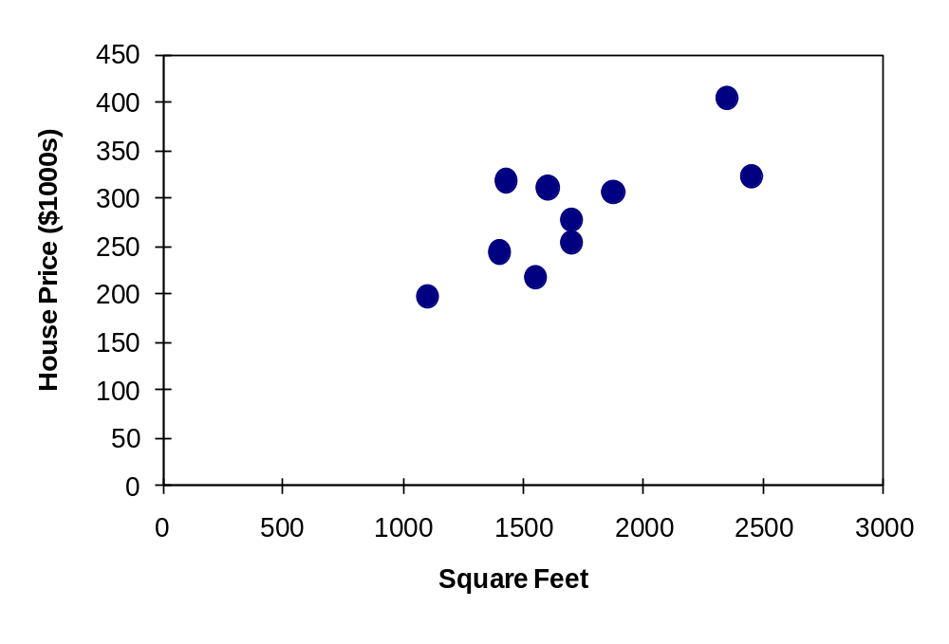
Simple Linear Regression Example: Scatter Plot
House price model: Scatter Plot
Chap 13-<number>

Slide 18
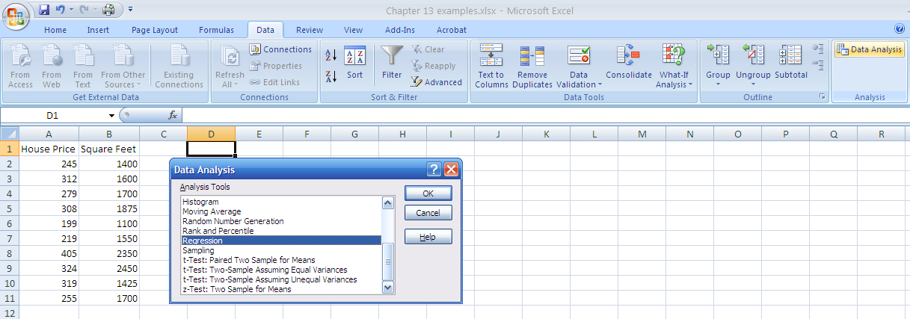
Simple Linear Regression Example: Using Excel Data Analysis Function
1. Choose Data
2. Choose Data Analysis
3. Choose Regression
Chap 13-<number>

Slide 19
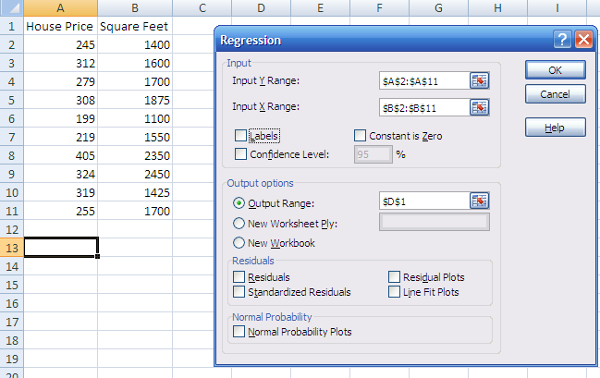
Simple Linear Regression Example: Using Excel Data Analysis Function
(continued)
Enter Y range and X range and desired options
Chap 13-<number>

Slide 20
Simple Linear Regression Example: Excel Output
Regression Statistics
Multiple R | 0.76211
R Square | 0.58082
Adjusted R Square | 0.52842
Standard Error | 41.33032
Observations | 10
ANOVA | df | SS | MS | F | Significance F
Regression | 1 | 18934.9348 | 18934.9348 | 11.0848 | 0.01039
Residual | 8 | 13665.5652 | 1708.1957
Total | 9 | 32600.5000
 | Coefficients | Standard Error | t Stat | P-value | Lower 95% | Upper 95%
Intercept | 98.24833 | 58.03348 | 1.69296 | 0.12892 | -35.57720 | 232.07386
Square Feet | 0.10977 | 0.03297 | 3.32938 | 0.01039 | 0.03374 | 0.18580
The regression equation is:
Chap 13-<number>

Slide 21
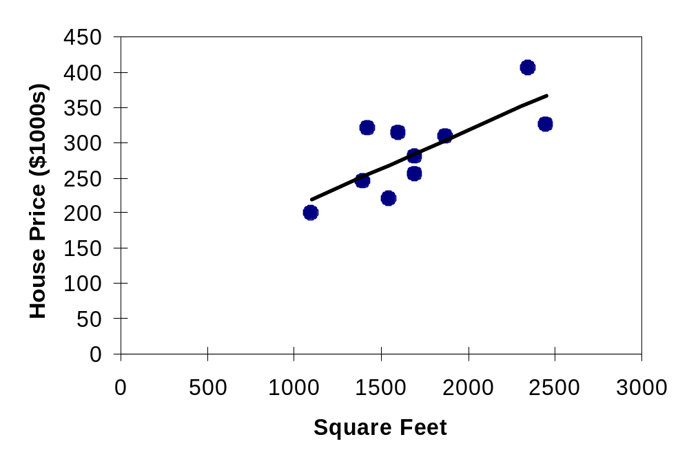
Simple Linear Regression Example: Graphical Representation
House price model: Scatter Plot and Prediction Line
Slope
= 0.10977
Intercept
= 98.248
Chap 13-<number>

Slide 22
Simple Linear Regression Example: Interpretation of b_{o}
b₀ is the estimated average value of Y when the value of X is zero (if X = 0 is in the range of observed X values)
Because a house cannot have a square footage of 0, b₀ has no practical application
Chap 13-<number>

Slide 23
Simple Linear Regression Example: Interpreting b₁
b₁ estimates the change in the average value of Y as a result of a one-unit increase in X
  Here, b₁ = 0.10977 tells us that the mean value of a house increases by .10977($1000) = $109.77, on average, for each additional one square foot of size
Chap 13-<number>

Slide 24
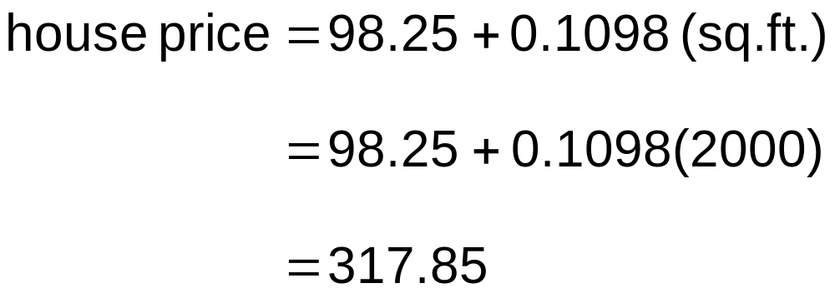
Simple Linear Regression Example: Making Predictions
Predict the price for a house with 2000 square feet:
The predicted price for a house with 2000 square feet is 317.85($1,000s) = $317,850
Chap 13-<number>

Slide 25
Simple Linear Regression Example: Making Predictions
When using a regression model for prediction, only predict within the relevant range of data
Relevant range for interpolation
Do not try to extrapolate beyond the range of observed X’s
Chap 13-<number>

Slide 26

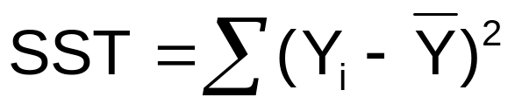
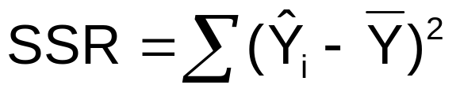
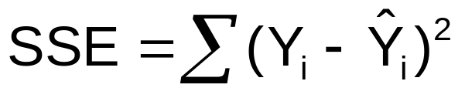


Measures of Variation
Total variation is made up of two parts:
Total Sum of Squares
Regression Sum of Squares
Error Sum of Squares
where:
= Mean value of the dependent variable
Y_{i} = Observed value of the dependent variable
= Predicted value of Y for the given X_{i} value
Chap 13-<number>

Slide 27
Measures of Variation
(continued)
SST = total sum of squares (Total Variation)
  Measures the variation of the Y_{i} values around their mean Y
SSR = regression sum of squares (Explained Variation)
  Variation attributable to the relationship between X and Y
SSE = error sum of squares (Unexplained Variation)
  Variation in Y attributable to factors other than X
Chap 13-<number>

Slide 28
Measures of Variation
(continued)
Y
Y_{i}
∧
∧
SSE = ∑(Y_{i} - Y_{i} )²
Y
_
SST = ∑(Y_{i} - Y)²
∧
Y
_
∧
_
SSR = ∑(Y_{i} - Y)²
_
Y
Y
X
X_{i}
Chap 13-<number>

Slide 29
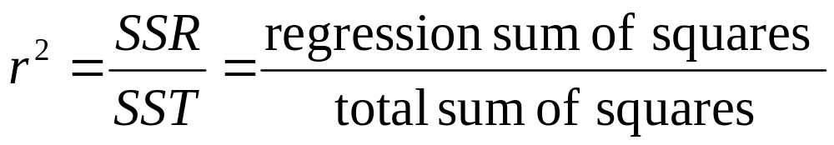
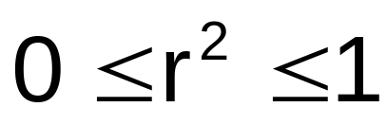
Coefficient of Determination, r²
The coefficient of determination is the portion of the total variation in the dependent variable that is explained by variation in the independent variable
The coefficient of determination is also called r-squared and is denoted as r²
r² is also the sample correlation coefficient
Chap 13-<number>

Slide 30
Examples of Approximate r² Values
Y
r² = 1
Perfect linear relationship between X and Y:
100% of the variation in Y is explained by variation in X
X
r² = 1
Y
X
r² = 1
Chap 13-<number>

Slide 31
Examples of Approximate r² Values
Y
0 < r² < 1
Weaker linear relationships between X and Y:
Some but not all of the variation in Y is explained by variation in X
X
Y
X
Chap 13-<number>

Slide 32
Examples of Approximate r² Values
r² = 0
Y
No linear relationship between X and Y:
The value of Y does not depend on X. (None of the variation in Y is explained by variation in X)
X
r² = 0
Chap 13-<number>

Slide 33
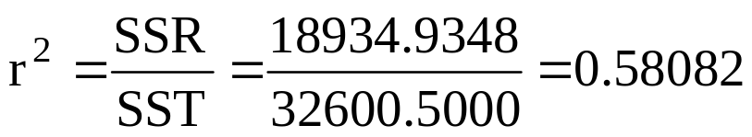
Simple Linear Regression Example: Coefficient of Determination, r² in Excel
Regression Statistics
Multiple R | 0.76211
R Square | 0.58082
Adjusted R Square | 0.52842
Standard Error | 41.33032
Observations | 10
ANOVA | df | SS | MS | F | Significance F
Regression | 1 | 18934.9348 | 18934.9348 | 11.0848 | 0.01039
Residual | 8 | 13665.5652 | 1708.1957
Total | 9 | 32600.5000
 | Coefficients | Standard Error | t Stat | P-value | Lower 95% | Upper 95%
Intercept | 98.24833 | 58.03348 | 1.69296 | 0.12892 | -35.57720 | 232.07386
Square Feet | 0.10977 | 0.03297 | 3.32938 | 0.01039 | 0.03374 | 0.18580
58.08% of the variation in house prices is explained by variation in square feet
Chap 13-<number>

Slide 34
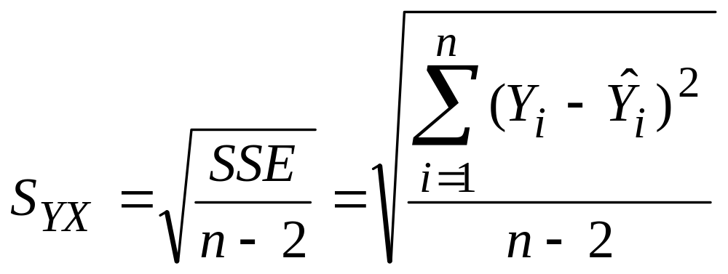
Standard Error of Estimate
The standard deviation of the variation of observations around the regression line is estimated by
Where
SSE = error sum of squares
n = sample size
Chap 13-<number>

Slide 35
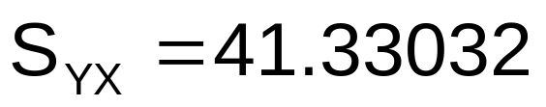
Simple Linear Regression Example:
Standard Error of Estimate in Excel
Regression Statistics
Multiple R | 0.76211
R Square | 0.58082
Adjusted R Square | 0.52842
Standard Error | 41.33032
Observations | 10
ANOVA | df | SS | MS | F | Significance F
Regression | 1 | 18934.9348 | 18934.9348 | 11.0848 | 0.01039
Residual | 8 | 13665.5652 | 1708.1957
Total | 9 | 32600.5000
 | Coefficients | Standard Error | t Stat | P-value | Lower 95% | Upper 95%
Intercept | 98.24833 | 58.03348 | 1.69296 | 0.12892 | -35.57720 | 232.07386
Square Feet | 0.10977 | 0.03297 | 3.32938 | 0.01039 | 0.03374 | 0.18580
Chap 13-<number>

Slide 36


Comparing Standard Errors
S_{YX} is a measure of the variation of observed Y values from the regression line
Y
Y
X
X
The magnitude of S_{YX} should always be judged relative to the size of the Y values in the sample data
i.e., S_{YX} = $41.33K is moderately small relative to house prices in the $200K - $400K range
Chap 13-<number>

Slide 37
Examples
## 13.12, 13.13
## 13.21, 13.22 (Excel)
Chap 13-<number>

Slide 38
Assumptions of Regression
L.I.N.E
Linearity
  The relationship between X and Y is linear
Independence of Errors
  Error values are statistically independent
Normality of Error
  Error values are normally distributed for any given value of X
Equal Variance (also called homoscedasticity)
  The probability distribution of the errors has constant variance
Chap 13-<number>

Slide 39
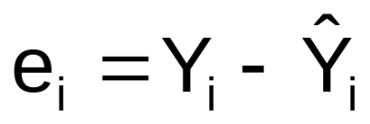
Residual Analysis
The residual for observation i, e_{i}, is the difference between its observed and predicted value
Check the assumptions of regression by examining the residuals
  Examine for linearity assumption
  Evaluate independence assumption
  Evaluate normal distribution assumption
  Examine for constant variance for all levels of X (homoscedasticity)
Graphical Analysis of Residuals
  Can plot residuals vs. X
Chap 13-<number>

Slide 40

Residual Analysis for Linearity
Y
Y
x
x
residuals
x
x
residuals
Not Linear
✓
Linear
Chap 13-<number>

Slide 41

Residual Analysis for Independence
Not Independent
✓
Independent
residuals
X
residuals
X
residuals
X
Chap 13-<number>

Slide 42
Checking for Normality
Examine the Stem-and-Leaf Display of the Residuals
Examine the Boxplot of the Residuals
Examine the Histogram of the Residuals
Construct a Normal Probability Plot of the Residuals
Chap 13-<number>

Slide 43
Residual Analysis for Normality
When using a normal probability plot, normal errors will approximately display in a straight line
Percent
100
0
-3 -2 -1 0 1 2 3
Residual
Chap 13-<number>

Slide 44

Residual Analysis for
Equal Variance
Y
Y
x
x
residuals
x
x
residuals
✓
Non-constant variance
Constant variance
Chap 13-<number>

Slide 45
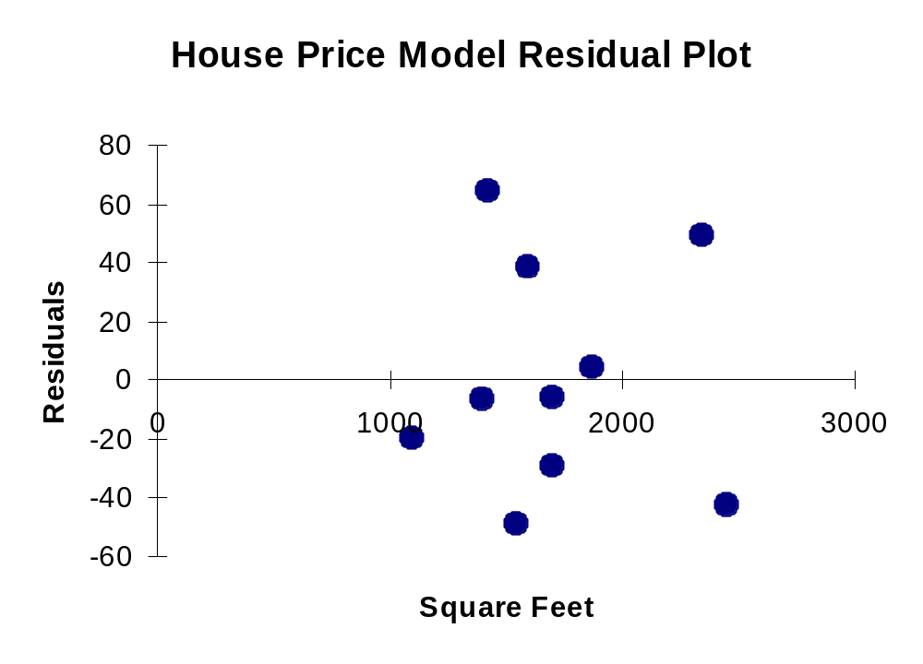
Simple Linear Regression Example: Excel Residual Output
RESIDUAL OUTPUT
 | Predicted House Price | Residuals
1 | 251.92316 | -6.923162
2 | 273.87671 | 38.12329
3 | 284.85348 | -5.853484
4 | 304.06284 | 3.937162
5 | 218.99284 | -19.99284
6 | 268.38832 | -49.38832
7 | 356.20251 | 48.79749
8 | 367.17929 | -43.17929
9 | 254.6674 | 64.33264
10 | 284.85348 | -29.85348
Does not appear to violate
any regression assumptions
Chap 13-<number>

Slide 46
Examples
## 13.23-13.24
## 13.29, 13.31 (Excel)
Chap 13-<number>

Slide 47
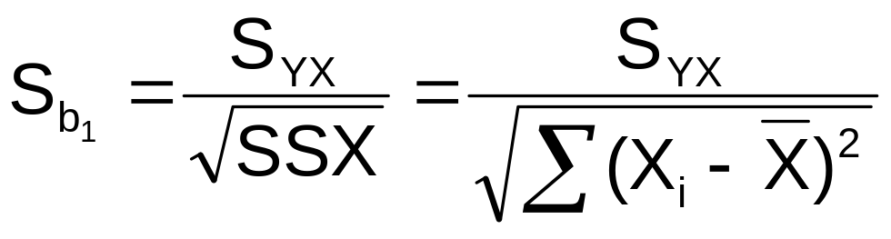
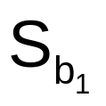
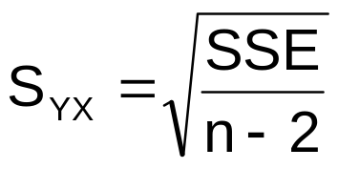
Inferences About the Slope
The standard error of the regression slope coefficient (b₁) is estimated by
where:
= Estimate of the standard error of the slope
= Standard error of the estimate
Chap 13-<number>

Slide 48
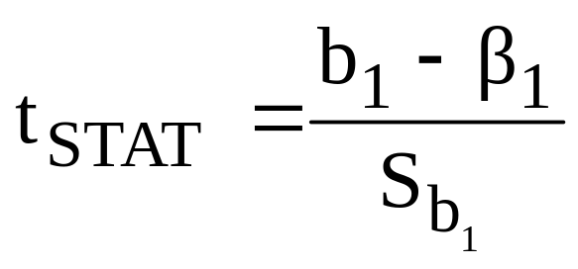

Inferences About the Slope: t Test
t test for a population slope
  Is there a linear relationship between X and Y?
Null and alternative hypotheses
  H₀: β₁ = 0 (no linear relationship)
  H₁: β₁ ≠ 0 (linear relationship does exist)
Test statistic
where:
b₁ = regression slope
coefficient
β₁ = hypothesized slope
S_{b1} = standard
error of the slope
Chap 13-<number>

Slide 49
Inferences About the Slope: t Test Example
Estimated Regression Equation:
House Price in $1000s (y) | Square Feet (x)
245 | 1400
312 | 1600
279 | 1700
308 | 1875
199 | 1100
219 | 1550
405 | 2350
324 | 2450
319 | 1425
255 | 1700
The slope of this model is 0.1098
Is there a relationship between the square footage of the house and its sales price?
Chap 13-<number>

Slide 50
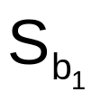
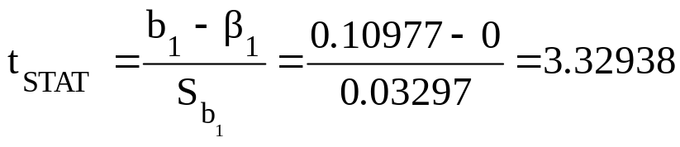
Inferences About the Slope: t Test Example
H₀: β₁ = 0
H₁: β₁ ≠ 0
From Excel output:
 | Coefficients | Standard Error | t Stat | P-value
Intercept | 98.24833 | 58.03348 | 1.69296 | 0.12892
Square Feet | 0.10977 | 0.03297 | 3.32938 | 0.01039
b₁
Chap 13-<number>

Slide 51
Inferences About the Slope: t Test Example
H₀: β₁ = 0
H₁: β₁ ≠ 0
Test Statistic: t_{STAT} = 3.329
d.f. = 10- 2 = 8
Decision: Reject H₀
α/2=.025
α/2=.025
There is sufficient evidence that square footage affects house price
Reject H₀
Do not reject H₀
Reject H₀
-t_{α/2}
t_{α/2}
0
-2.3060
2.3060
3.329
Chap 13-<number>

Slide 52
Inferences About the Slope: t Test Example
H₀: β₁ = 0
H₁: β₁ ≠ 0
From Excel output:
 | Coefficients | Standard Error | t Stat | P-value
Intercept | 98.24833 | 58.03348 | 1.69296 | 0.12892
Square Feet | 0.10977 | 0.03297 | 3.32938 | 0.01039
p-value
Decision: Reject H₀, since p-value < α
There is sufficient evidence that square footage affects house price.
Chap 13-<number>

Slide 53
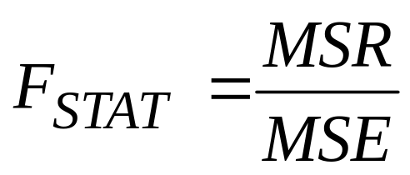
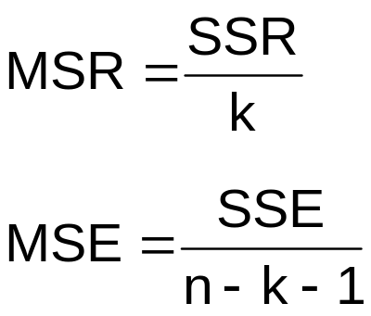
F Test for Significance
F Test statistic:
where
where F_{STAT} follows an F distribution with k numerator and (n – k - 1) denominator degrees of freedom
(k = the number of independent variables in the regression model)
Chap 13-<number>

Slide 54
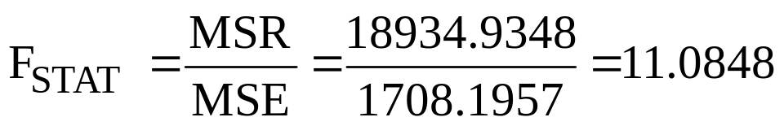
F-Test for Significance
Excel Output
Regression Statistics
Multiple R | 0.76211
R Square | 0.58082
Adjusted R Square | 0.52842
Standard Error | 41.33032
Observations | 10
ANOVA | df | SS | MS | F | Significance F
Regression | 1 | 18934.9348 | 18934.9348 | 11.0848 | 0.01039
Residual | 8 | 13665.5652 | 1708.1957
Total | 9 | 32600.5000
With 1 and 8 degrees of freedom
p-value for the F-Test
Chap 13-<number>

Slide 55
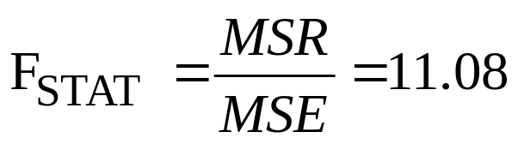
F Test for Significance
(continued)
H₀: β₁ = 0
H₁: β₁ ≠ 0
α = .05
df₁= 1 df₂ = 8
Test Statistic:
Decision:
Conclusion:
Critical Value:
F_{α} = 5.32
Reject H₀ at α = 0.05
α = .05
There is sufficient evidence that house size affects selling price
0
F
Do not
reject H₀
Reject H₀
F_{.05} = 5.32
Chap 13-<number>

Slide 56
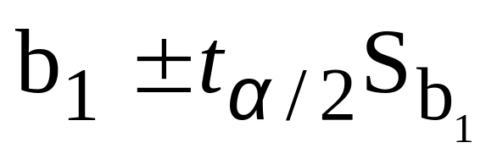
Confidence Interval Estimate for the Slope
Confidence Interval Estimate of the Slope:
d.f. = n - 2
Excel Printout for House Prices:
 | Coefficients | Standard Error | t Stat | P-value | Lower 95% | Upper 95%
Intercept | 98.24833 | 58.03348 | 1.69296 | 0.12892 | -35.57720 | 232.07386
Square Feet | 0.10977 | 0.03297 | 3.32938 | 0.01039 | 0.03374 | 0.18580
At 95% level of confidence, the confidence interval for the slope is (0.0337, 0.1858)
Chap 13-<number>

Slide 57
Confidence Interval Estimate for the Slope
(continued)
 | Coefficients | Standard Error | t Stat | P-value | Lower 95% | Upper 95%
Intercept | 98.24833 | 58.03348 | 1.69296 | 0.12892 | -35.57720 | 232.07386
Square Feet | 0.10977 | 0.03297 | 3.32938 | 0.01039 | 0.03374 | 0.18580
Since the units of the house price variable is $1000s, we are 95% confident that the average impact on sales price is between $33.74 and $185.80 per square foot of house size
This 95% confidence interval does not include 0.
Conclusion: There is a significant relationship between house price and square feet at the .05 level of significance
Chap 13-<number>

Slide 58
Examples
## 13.39, 13.40, 13.41
## 13.47, 13.48, 13.52 (Excel)
Chap 13-<number>

Slide 59
Estimating Mean Values and Predicting Individual Values
Goal: Form intervals around Y to express uncertainty about the value of Y for a given X_{i}
Confidence Interval for the mean of Y, given X_{i}
Y
∧
Y
∧
Y = b₀+b₁X_{i}
Prediction Interval for an individual Y, given X_{i}
X_{i}
X
Chap 13-<number>

Slide 60
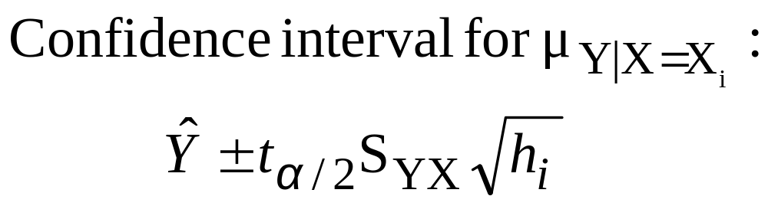
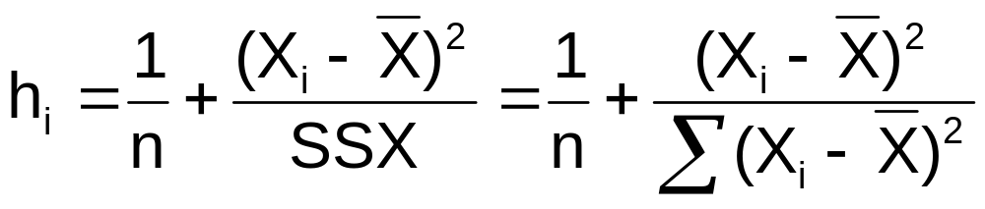
Confidence Interval for the Average Y, Given X
Confidence interval estimate for the
mean value of Y given a particular X_{i}
Size of interval varies according to distance away from mean, X
Chap 13-<number>

Slide 61
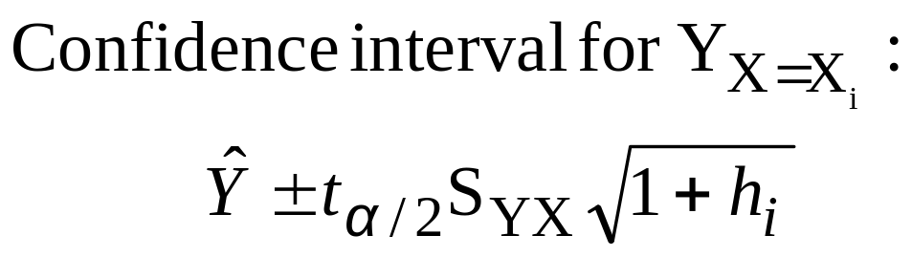
Prediction Interval for an Individual Y, Given X
Confidence interval estimate for an
Individual value of Y given a particular X_{i}
This extra term adds to the interval width to reflect the added uncertainty for an individual case
Chap 13-<number>

Slide 62
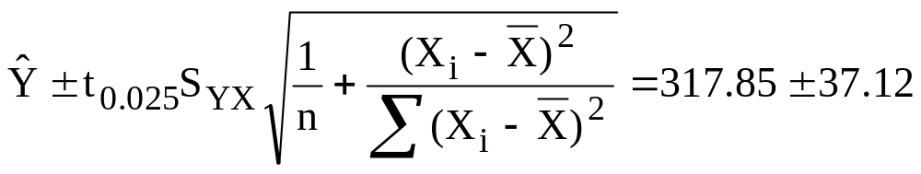
Estimation of Mean Values: Example
Confidence Interval Estimate for μ_{Y|X=X}
i
Find the 95% confidence interval for the mean price of 2,000 square-foot houses
∧
Predicted Price Y_{i} = 317.85 ($1,000s)
The confidence interval endpoints (from Excel) are 280.66 and 354.90, or from $280,660 to $354,900
Chap 13-<number>

Slide 63
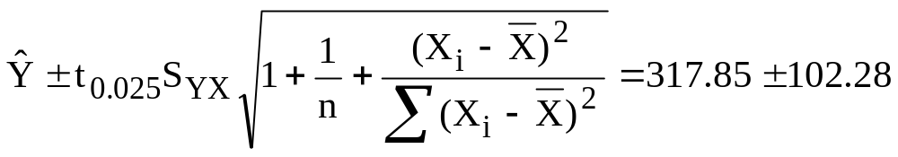
Estimation of Individual Values: Example
Prediction Interval Estimate for Y_{X=X}
i
Find the 95% prediction interval for an individual house with 2,000 square feet
∧
Predicted Price Y_{i} = 317.85 ($1,000s)
The prediction interval endpoints from Excel are 215.50 and 420.07, or from $215,500 to $420,070
Chap 13-<number>

Slide 64
Examples
# 13.55
# 13.61
Chap 13-<number>

Slide 65
Pitfalls of Regression Analysis
Lacking an awareness of the assumptions underlying least-squares regression
Not knowing how to evaluate the assumptions
Not knowing the alternatives to least-squares regression if a particular assumption is violated
Using a regression model without knowledge of the subject matter
Extrapolating outside the relevant range
Chap 13-<number>

Slide 66
Strategies for Avoiding the Pitfalls of Regression
Start with a scatter plot of X vs. Y to observe possible relationship
Perform residual analysis to check the assumptions
  Plot the residuals vs. X to check for violations of assumptions such as homoscedasticity
  Use a histogram, stem-and-leaf display, boxplot, or normal probability plot of the residuals to uncover possible non-normality
Chap 13-<number>

Slide 67
Strategies for Avoiding the Pitfalls of Regression
(continued)
If there is violation of any assumption, use alternative methods or models
If there is no evidence of assumption violation, then test for the significance of the regression coefficients and construct confidence intervals and prediction intervals
Avoid making predictions or forecasts outside the relevant range
Chap 13-<number>

Slide 68
Chapter Summary
In this chapter we discussed
Types of regression models
The assumptions of regression and correlation
Determining the simple linear regression equation
Measures of variation
Residual analysis
Measuring autocorrelation
Chap 13-<number>

Slide 69
Chapter Summary
(continued)
Making inferences about the slope
Correlation -- measuring the strength of the association
The estimation of mean values and prediction of individual values
Possible pitfalls in regression and recommended strategies to avoid them
Chap 13-<number>

